Slide 1
POCUS PASSPORT:
AAA MINIMUM IMAGING SET AND AUDITING GUIDE

Slide 2
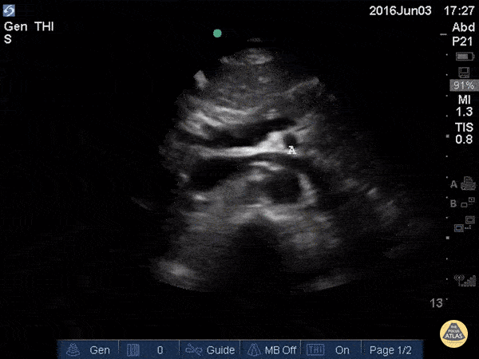
Transverse plane of proximal and distal (bifurcation)
Imaged at site of maximal aneurysmal dilatation if present
Curvilinear or phased array) transducer on EFAST, ABDO or VASCULAR preset
Anatomy - include vertebral body, aorta, IVC
Depth - adequate if no portion of aorta is cut-off OR aorta is not displayed in the superficial third of the image field
Gain/TGC - adequate to demonstrate aorta without over-gain obscuring lumen OR under-gain making tissues appear anechoic
Focal Zone – adequate if within +/- 5cm mid level of aorta Label – AO TRV
Label - Ao Proximal and Ao Distal
TRANSVERSE AORTA
Proximal

Slide 3
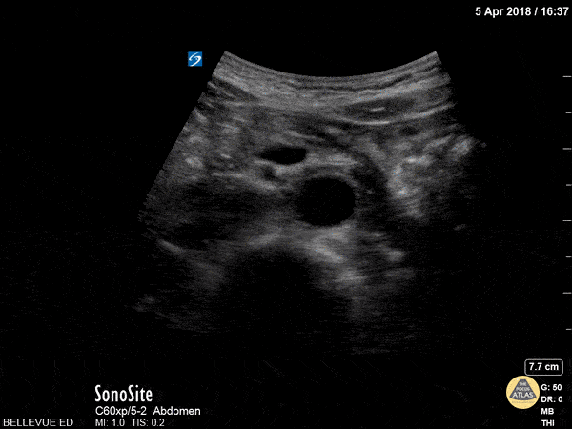
Transverse plane of proximal and distal (bifurcation)
Imaged at site of maximal aneurysmal dilatation if present
Curvilinear or phased array) transducer on EFAST, ABDO or VASCULAR preset
Anatomy - include vertebral body, aorta, IVC
Depth - adequate if no portion of aorta is cut-off OR aorta is not displayed in the superficial third of the image field
Gain/TGC - adequate to demonstrate aorta without over-gain obscuring lumen OR under-gain making tissues appear anechoic
Focal Zone – adequate if within +/- 5cm mid level of aorta Label – AO TRV
Label - Ao Proximal and Ao Distal
TRANSVERSE AORTA
Distal

Slide 4
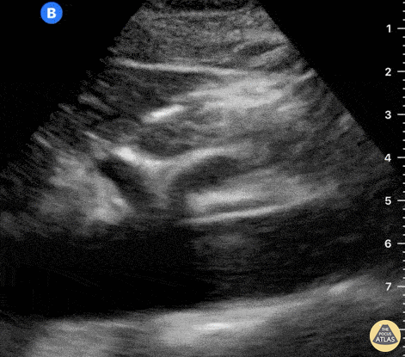
Longitudinal plane in central abdomen
Imaged at site of maximal aneurysmal dilatation if present
Curvilinear or phased array transducer on EFAST, ABDO or VASCULAR preset
Anatomy - include spine & aorta
Depth - adequate if no portion of aorta is cut-off OR aorta is not displayed in the superficial third of the image field
Gain/TGC - adequate to demonstrate aorta without over-gain obscuring lumen OR under-gain making tissues appear anechoic
Focal Zone – adequate if within +/- 5cm mid level of aorta
Label – AO LONG
LONG AORTA

Slide 5
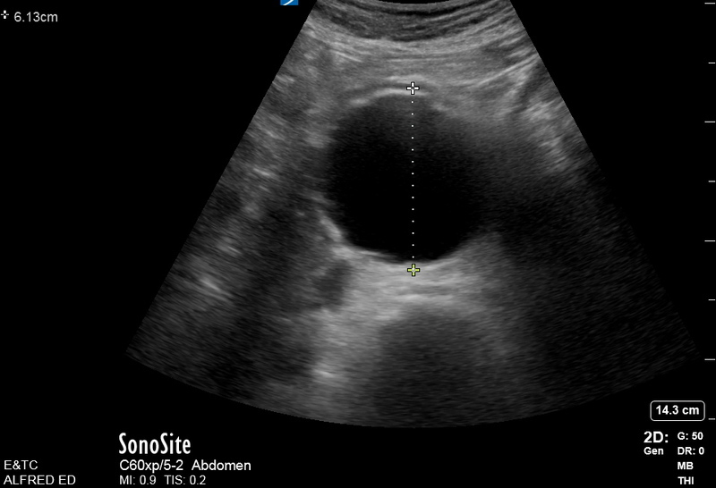
Single measurement ok in transverse from anterior to posterior outer wall to outer wall
If aneurysm present, then transverse image and longitudinal image at the point of largest diameter from outer wall to outerwall.
Aorta Measurements

